Slide 1


Point-to-point protocol exploration
Nayib Boukadida
n.boukadida@nikhef.nl
F. Schreuder
A. Borga
P. Jansweijer
W.E. Dolman

Slide 2
Content
About Nikhef
Internship assignment
Structure of communication protocols
Requirements
Survey of existing protocols (vendor dependent and independent)
The Interlaken protocol
Implementation
Status
Conclusion

Slide 3
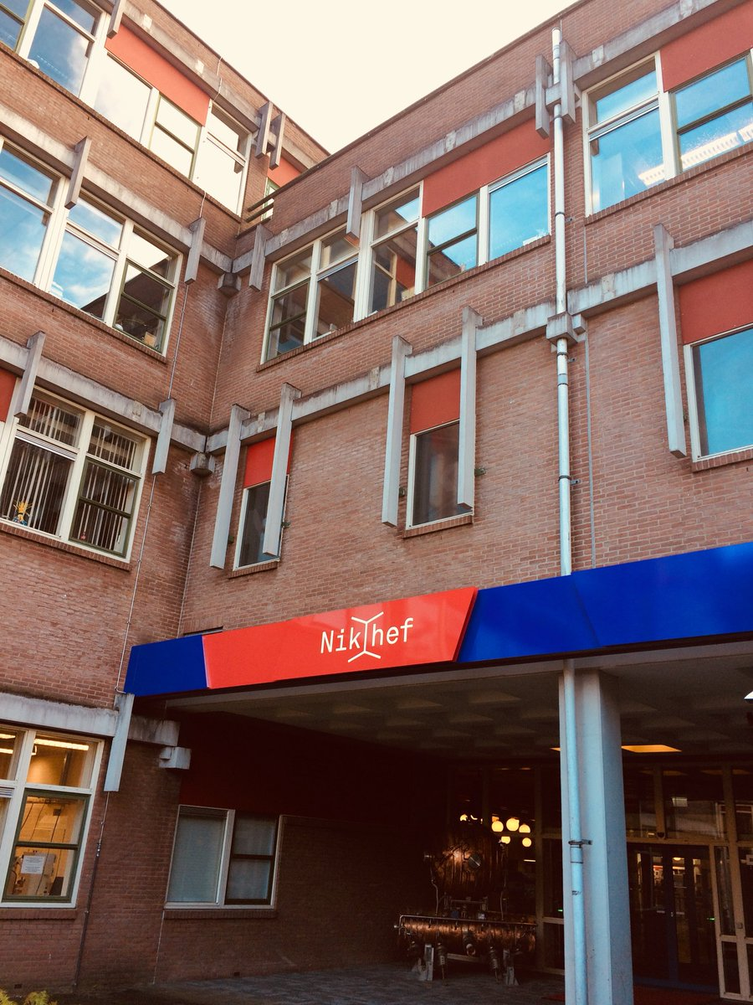
Nikhef
National Institute for Subatomic Physics (Nationaal Instituut voor Subatomaire fysica)
Among others, Nikhef is closely involved in the development of the LHC ATLAS experiment at CERN
Internship at the Electronic Technology department

Slide 4
Internship assignment
Large particle detector facilities often require a point-to-point link at a certain stage of the DataAcQuisition (DAQ) chain to connect custom tailored electronics
As the demand of data processing increases and larger data-sets are to be transported through these links their performance in terms of speed and bandwidth must scale accordingly
Because of this:
I was assigned the task to research and implement a novel high-speed point-to-point link targeting FPGA communication

Slide 5

Internship assignment
Explore how point-to-point communication protocols are built up
Survey the currently existing point-to-point protocols
Find out if there is an existing protocol that matches a set of clear requirements
Describe the protocol and implement a proof of concept that can run on an FPGA [possibly vendor independent]
Publish specifications and implementation as Free and Open Source on specialized code hosting platforms like OpenCores
sharing is done with the aim of promoting the dissemination and broad adoption of the design
Notes:
I was asked to…

Slide 6
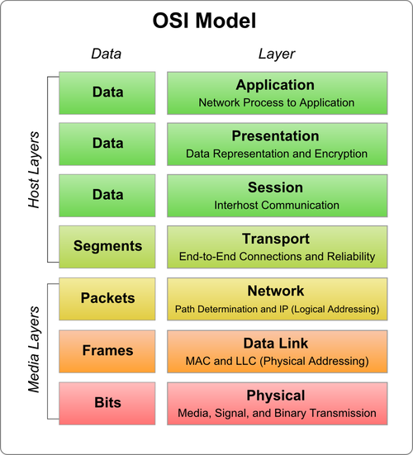
Point-to-point protocols
Open Systems Interconnection (OSI) model
Describes how data communication between two peers should take place
Focused on FPGA
The media layer will be of most interest to us
Layer 1 : Physical (PHY)
Layer 2 : Data link (MAC)

Slide 7
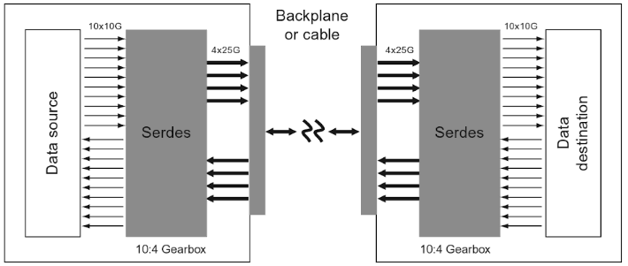
Point-to-point protocols
Data structure and framing (OSI Layer 2)
Adds overhead for the peers to properly handle payload data
Error detection and correction (OSI Layer 2/1)
Checks on erroneous/flipped bits
Encoding of data (OSI Layer 1)
Ensures the data will arrive “electrically” correct
Serialization and deserialization of data (OSI Layer 1)
Long distance communication happens over serial link [stating the obvious]

Slide 8
Line encoding and decoding
Encoding adds sync headers and randomizes the binary data
Prevents baseline wander, constant EMI
Prevents errors in delineation of words
Essential for clock recovery
Scrambler
Randomizes the data according to an algorithm
Can be reversed by the receiver [this is not encryption]
Prevents long rows of continuous binary values
Can be self-synchronous (on payload) or independent synchronous (per lane)
Commonly used:
8b/10b - DVI / HDMI / Gbit Eth SGMI / SATA / USB 3.0
64b/66b - Ethernet / InfiniBand / Thunderbolt
128b/130b - PCIe 3.0/4.0
128b/132b - USB 3.1
256b/257b - Fibrechannel
64b/67b - Interlaken

Slide 9
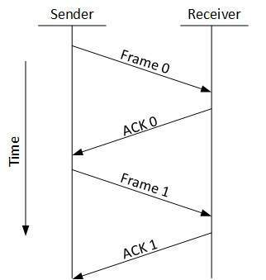
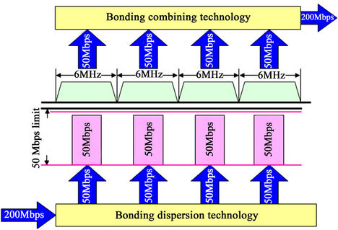
Flow control and bonding
Flow control
Start/stop transmitting at command of the receiver
Prevents overwhelming the receiver
Channel Bonding
Combining multiple serial links in parallel
Increases throughput

Slide 10
Requirements
Mandatory:
Line rate must be at least 10 Gbit/s (1,25 GB/s)
Flow control must be present
Range distance coverage has to be 10 - 200 meters (normal distance)
Optional:
Cyclic Redundancy Check
Forward Error Correction
Channel bonding

Slide 11
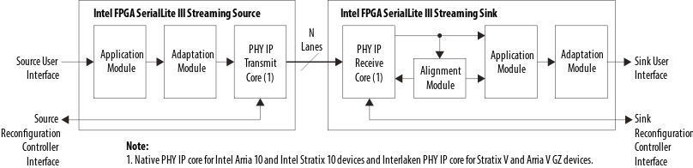
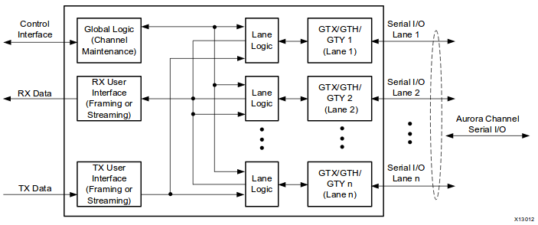
Survey
Vendor dependent protocols
Altera SerialLite II & III
Speeds up to 28 Gbit/s (Transceiver dependent)
SLII supports flow control / SLIII not very clear
CRC-32 Error Correction
FEC not mentioned
64b/67b encoding
Xilinx Aurora 8b/10b & 64b/66b
Speeds up to 26 Gbit/s (Transceiver dependent)
Flow control
CRC-32 Error correction
FEC not mentioned
64b/66b encoding
Microsemi litefast – Somewhat older

Slide 12
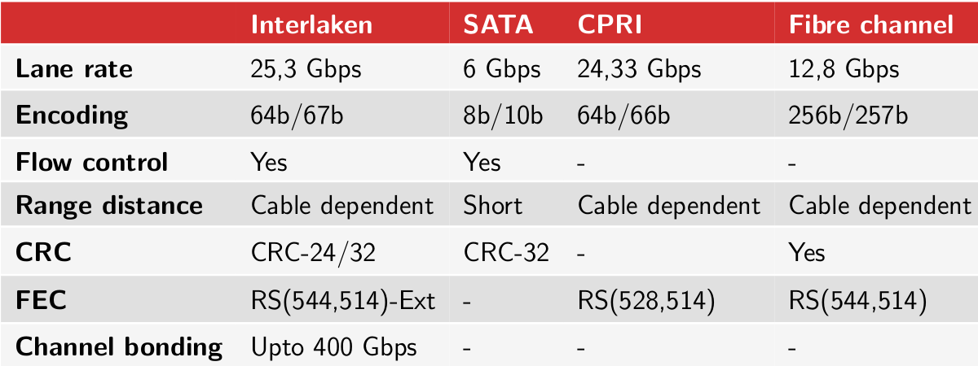
Survey
This slide is explicitly full of stuff! ☺
Vendor independent protocols
Interlaken
Clear documentation
meets all requirements by a fair margin
SATA
Lane rate is not sufficient
Older 8b/10b encoding
Includes flow control / CRC-32
Not open source
No bonding
CPRI
Unclear documentation
Sufficient lane rate and encoding
Channel bonding not supported
HyperTransport
High speeds
Parallel bus
Fibre Channel
No documentation found
Only old presentations to be found
Not open
XAUI
Combines multiple slower line to 10 Gbps link
Used in combination with Ethernet

Slide 13
Survey
This slide is explicitly full of stuff! ☺
Vendor independent protocols
Interlaken
Clear documentation
meets all requirements by a fair margin
SATA
Lane rate is not sufficient
Older 8b/10b encoding
Includes flow control / CRC-32
Not open source
No bonding
CPRI
Unclear documentation
Sufficient lane rate and encoding
Channel bonding not supported
HyperTransport
High speeds
Parallel bus
Fibre Channel
No documentation found
Only old presentations to be found
Not open
XAUI
Combines multiple slower line to 10 Gbps link
Used in combination with Ethernet

Slide 14
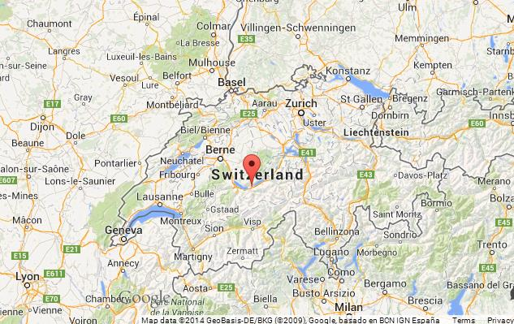

The Interlaken Protocol
Revision 1.2 October 7, 2008
Property of Cortina Systems and Cisco Systems
Royalty-free
Interlaken Alliance
Many members, among others:
Broadcom, Intel, Lattice, Microsemi, Xilinx
It was made because…

Slide 15
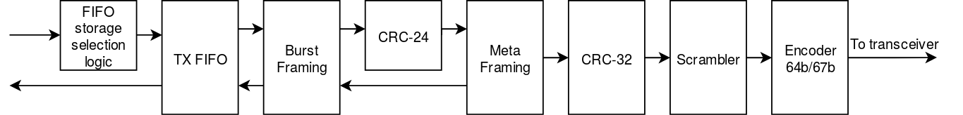
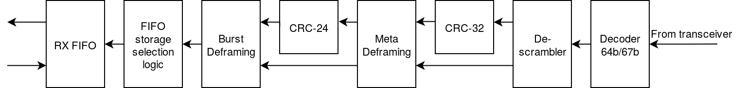
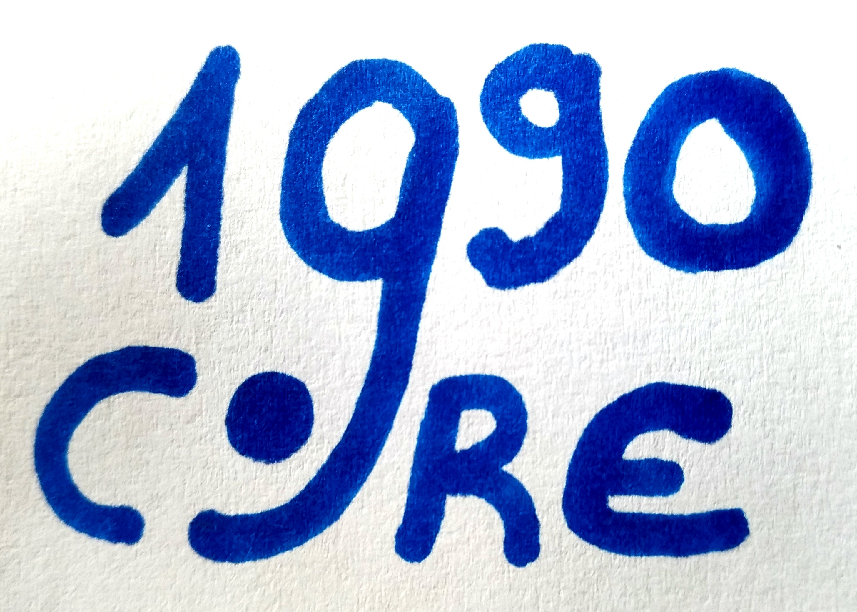
Implementation
Worked on a implementation in VHDL – target Xilinx VC707 board
Only the transceiver and FIFOs make use of a proprietary IP Core
Overhead (Single lane)
Bursts : BurstMax 32 (256 B), BurstMin 4 (32 B) -> 2/34 = 5,88% (Best case)
Metaframing : Metaframelength 2048 (16.384 B) -> 4/2048 = 0,20%
Encoding : 64b/67b -> 64/67 = 4,48%
Total overhead of about 10,3%
We called it Core1990

Slide 16
Status
Found a protocol that meets all requirements
Described the protocol extensively in a structured document
Vivado project is properly setup and design is synthesizable
Design functions verified in behavioral simulation
Complete transmitter and receiver chains
CRC-24 and receiving FIFO need some adjustments
Not yet tested in hardware

Slide 17
Conclusion
Gained knowledge
Much more experience in writing correct VHDL
Better idea of how to analyze IP Core documentation
More confident in designing according to specs
Navigate through a lot of signals in simulation
How to properly gather and research information
How to properly structure a specification document
My accomplishment is the first step
Others can learn from it and continue its development
Information and documentation will be uploaded to:
https://opencores.org/project/core1990_interlaken

Slide 18
Conclusion
Gained knowledge
Much more experience in writing correct VHDL
Better idea of how to analyze IP Core documentation
More confident in designing according to specs
Navigate through a lot of signals in simulation
How to properly gather and research information
How to properly structure a specification document
My accomplishment is the first step
Others can learn from it and continue its development
Information and documentation will be uploaded to:
https://opencores.org/project/core1990_interlaken
Thank you for your attention! ☺

Slide 19
Backup slides

Slide 20
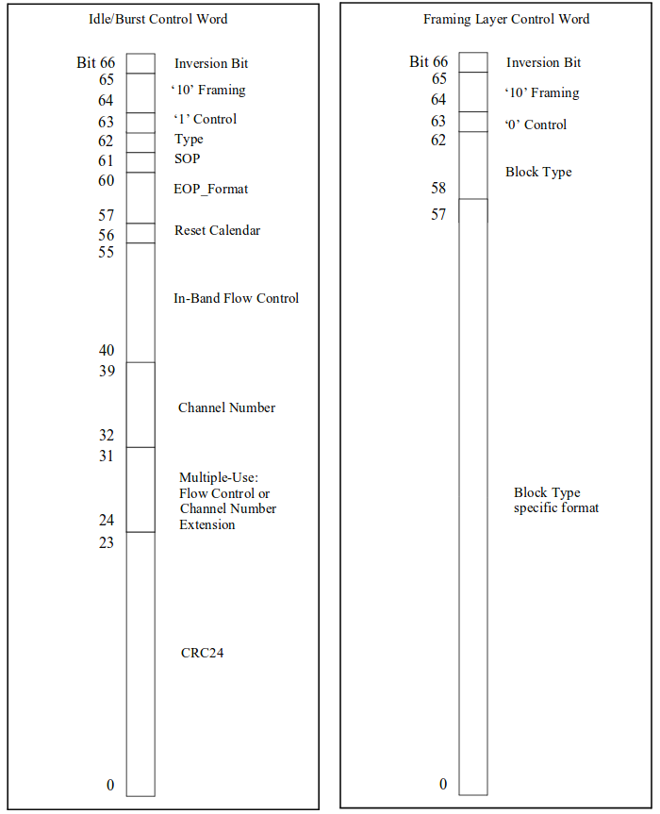
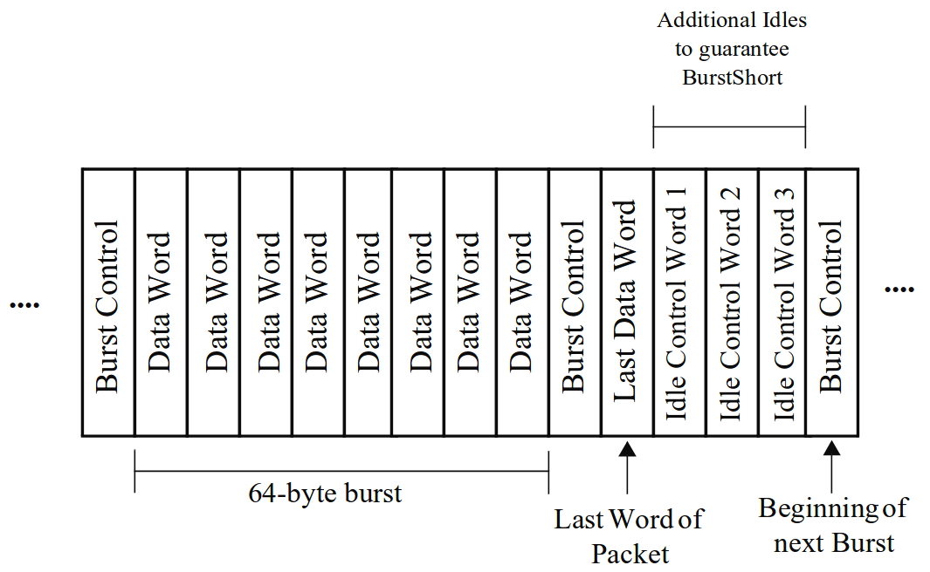
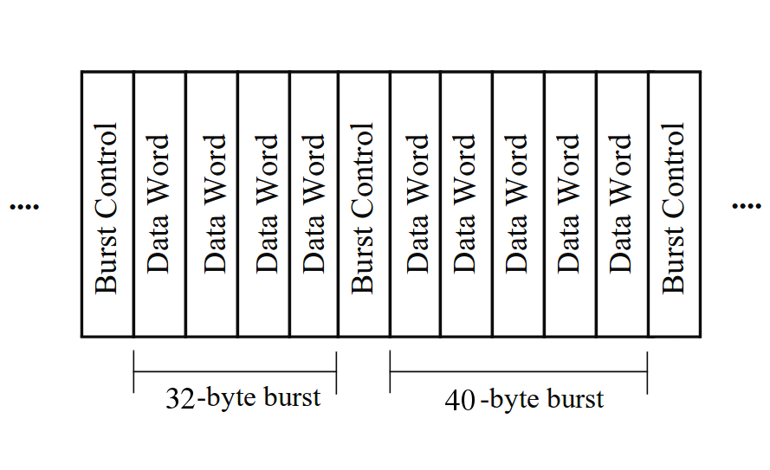
The Interlaken Protocol
This slide is a cheat sheet! ☺
Idle/burst and framing control words
Burst framing
Covered by CRC-24
Contains start and end
BurstMax
BurstMin
In-band flow control
Channel numbers
Burst example
Optional scheduling

Slide 21
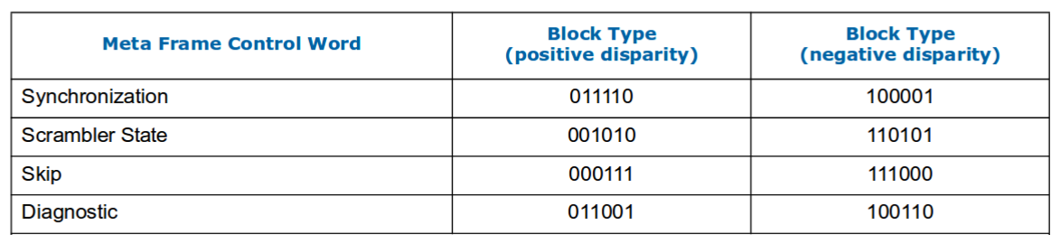
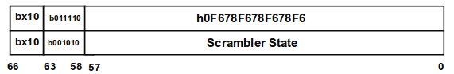
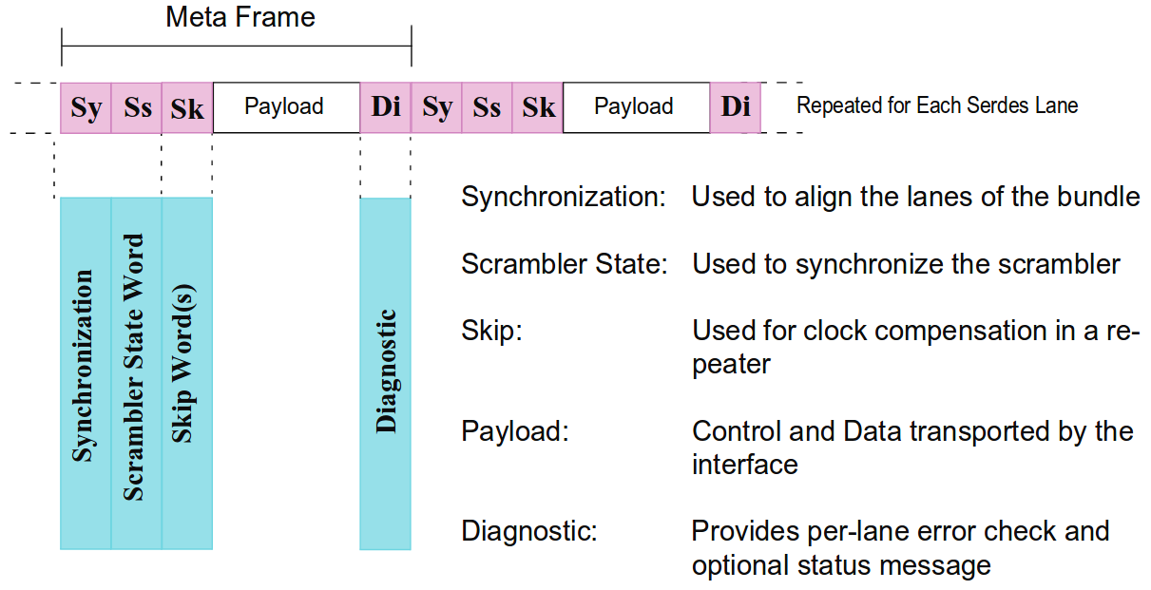
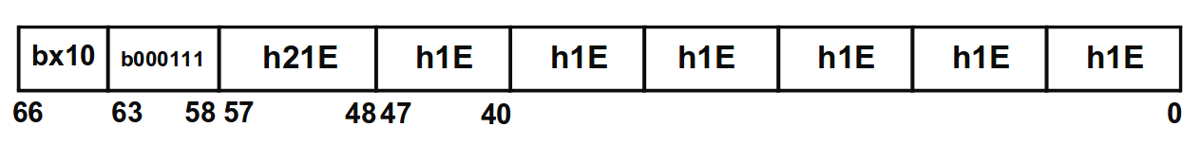
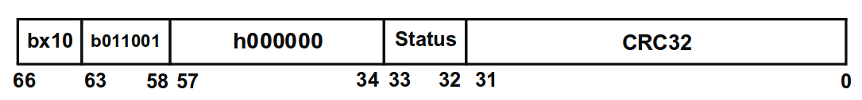
The Interlaken Protocol
This slide is also a cheat sheet! ☺
Meta framing
- Covered by CRC-32
- Synchronizes the connection
- Communicates scrambler states
- Skip words for clock synchronization
- Diagnostic information
Synchronization / Scrambler state
Skip word
Diagnostic word

Slide 22
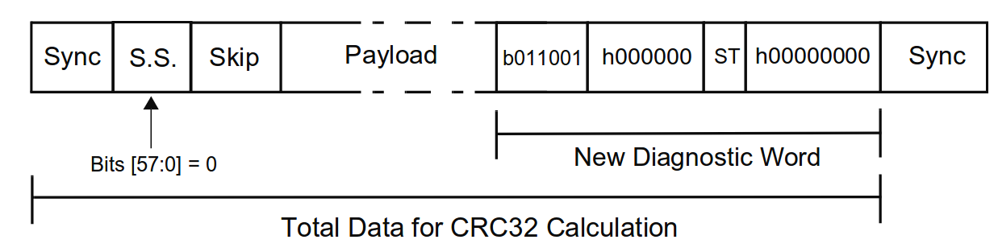
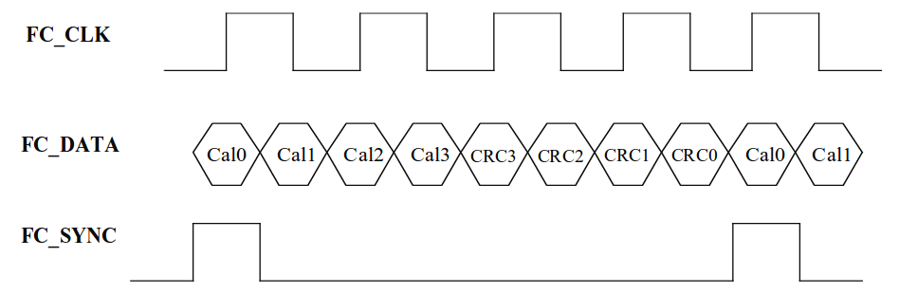
The Interlaken Protocol
This slide is also a cheat sheet! ☺
Flow Control
- XON/XOFF
In-band flow control
- Included in burst control words
- Intended for duplex operation
Out-of-band flow control
- Covered by CRC-4
- Intended for simplex operation
CRC-32 - Meta framing
X³²+X²⁸+X²⁷+X²⁶+X²⁵+X²³+X²²+X²⁰+X¹⁹+X¹⁸+
X¹⁴+X¹³+X¹¹+X¹⁰+X⁹+X⁸+X⁶+1
CRC-24 - Burst framing
X²⁴+X²¹+X²⁰+X¹⁷+X¹⁵+X¹¹+X⁹+X⁸+X⁶+X⁵+X+1
CRC-4 - Out-of-band flow control
X⁴+X+1

Slide 23
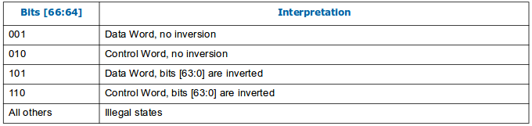
The Interlaken Protocol
This slide is also a cheat sheet! ☺
Scrambler
- Independent synchronous scrambler
- 58 bit polynomial : X⁵⁸+X³⁸+1
- No error multiplication through
multiple frames
- In case of error, synchronizes itself
Encoder
- Adds a 3-bit preamble
- 50% of combinations possible
- Running disparity within 96-bit
boundary
- Doesn’t rely on the scrambler
- Lower Bit-Error-Rate

